Slide 1


Slide 2
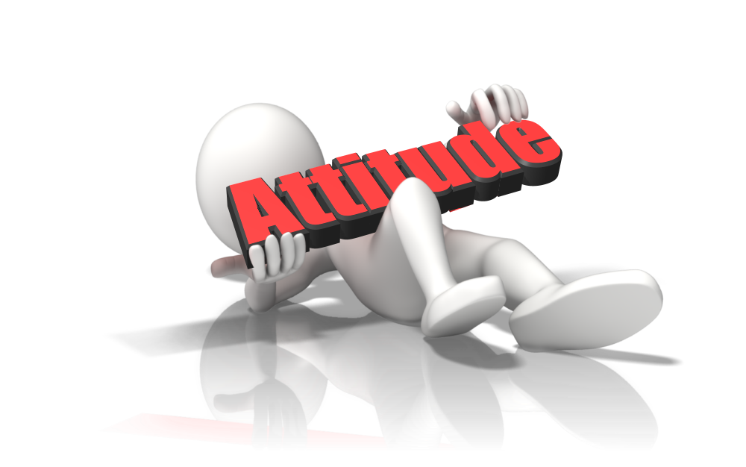
What is Attitude?
a feeling or opinion about something or someone
Behaviour towards someone or something that is caused by your feelings of them
position or posture of the body appropriate to or expressive of an action, emotion
Notes:
http://www.businessdictionary.com/definition/attitude.html
https://catalog.flatworldknowledge.com/bookhub/3?e=bauer-ch04_s01

Slide 3
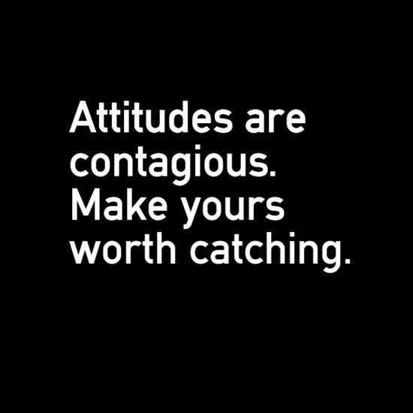
What is Attitude?
This affects :
Our opinions
Beliefs
Feelings about something and every aspects of our environment
Notes:
We have attitudes toward the food we eat, people we interact with, courses we take, and various other things

Slide 4

Choosing Your Attitude
Your attitude is a form of expression of yourself
You can choose to be happy, positive and optimistic
You can also choose to be pessimistic and critical, with a negative outlook on your workday
Notes:
https://www.quillgroup.com.au/blog/benefits-positive-attitude-workplace/

Slide 5

Choosing Your Attitude
Attitudes help to develop the prevailing workplace environment
Affects employee morale, productivity and team building abilities
Notes:
Workplace attitudes have an effect on every person in the organisation, from the employees to the clients

Slide 6
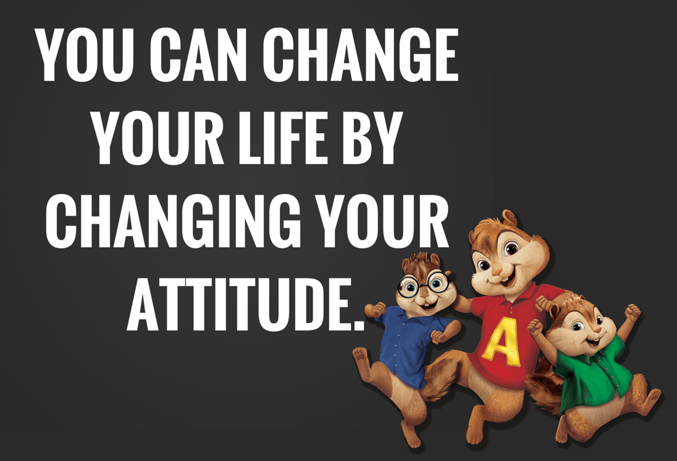
Choosing Your Attitude
A positive attitude helps you cope better under stressful situations at work
A negative attitude in the workplace creates an atmosphere of distrust among employees

Slide 7

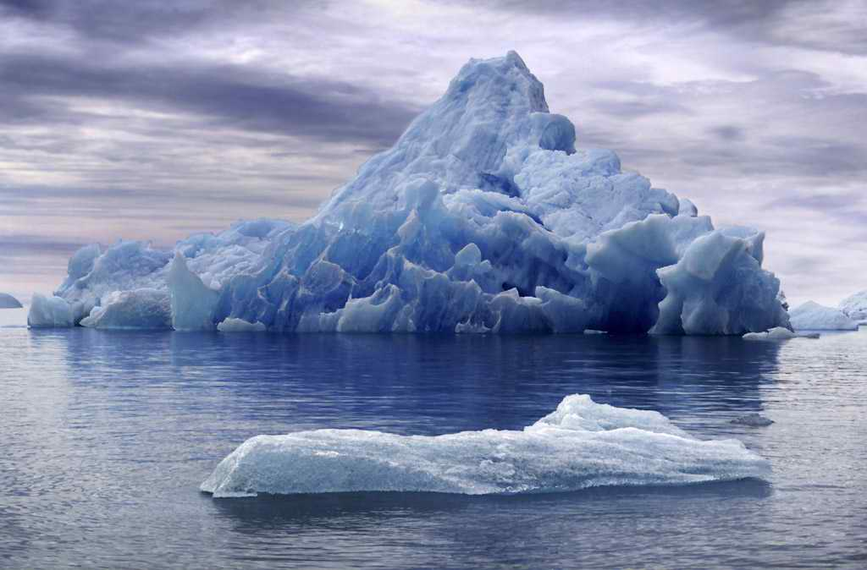
How Much Do You See of an ICEBERG?
Notes:
Do you see all the parts of an iceberg?

Slide 8
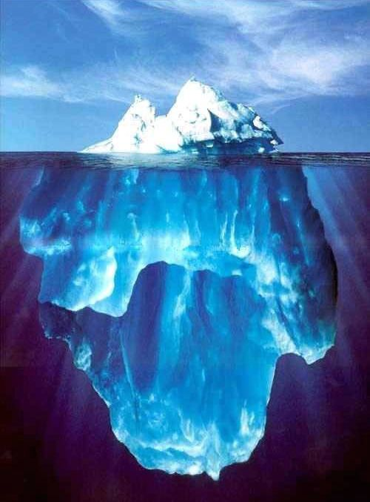

How Much Do You See of an ICEBERG?
ONLY 10% OF ANY ICEBERG IS VISIBLE.
THE REMAINING 90% IS BELOW SEA LEVEL.

Slide 9



How Much Do You See of an ICEBERG?
10%
VISIBLE
ABOVE SEA LEVEL
SEA LEVEL
INVISIBLE
BELOW SEA LEVEL
90%

Slide 10

How Much Do You See of an ICEBERG?
The ICEBERG Phenomena is also Applicable on Human Beings
Notes:
Everyone who sees you only see a little part of you (just 10%), they do not have the in-depth knowledge about you (90%)

Slide 11
How Much Do You See of an ICEBERG?
SKILLS
&
KNOWLEDGE
KNOWN
TO OTHERS
SEA LEVEL
UNKNOWN
TO OTHERS
ATTITUDE

Slide 12
THE
ICEBERG
IN
OTHER WORDS

Slide 13
BEHAVIOR
KNOWN
TO OTHERS
SEA LEVEL
UNKNOWN
TO OTHERS
IMPACT
VALUES – STANDARDS – JUDGMENTS
ATTITUDE
MOTIVES – ETHICS - BELIEFS

Slide 14
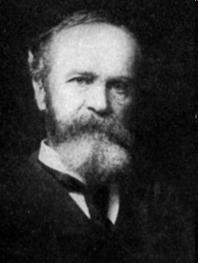
“Whenever you're in conflict with someone, there is one factor that can make the difference between damaging your relationship and deepening it. That factor is attitude”
William James

Slide 15
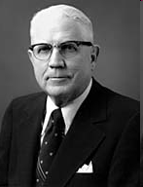
“Everything depends on attitude. We are ambitious or lazy, enthusiastic or dull, loyal or undependable, according to our attitude. We get good grades or poor grades - according to our attitudes. Discouragement is an attitude. Lack of industry is an attitude. Failure to follow instructions is an attitude.”
Sterling W. Sill

Slide 16
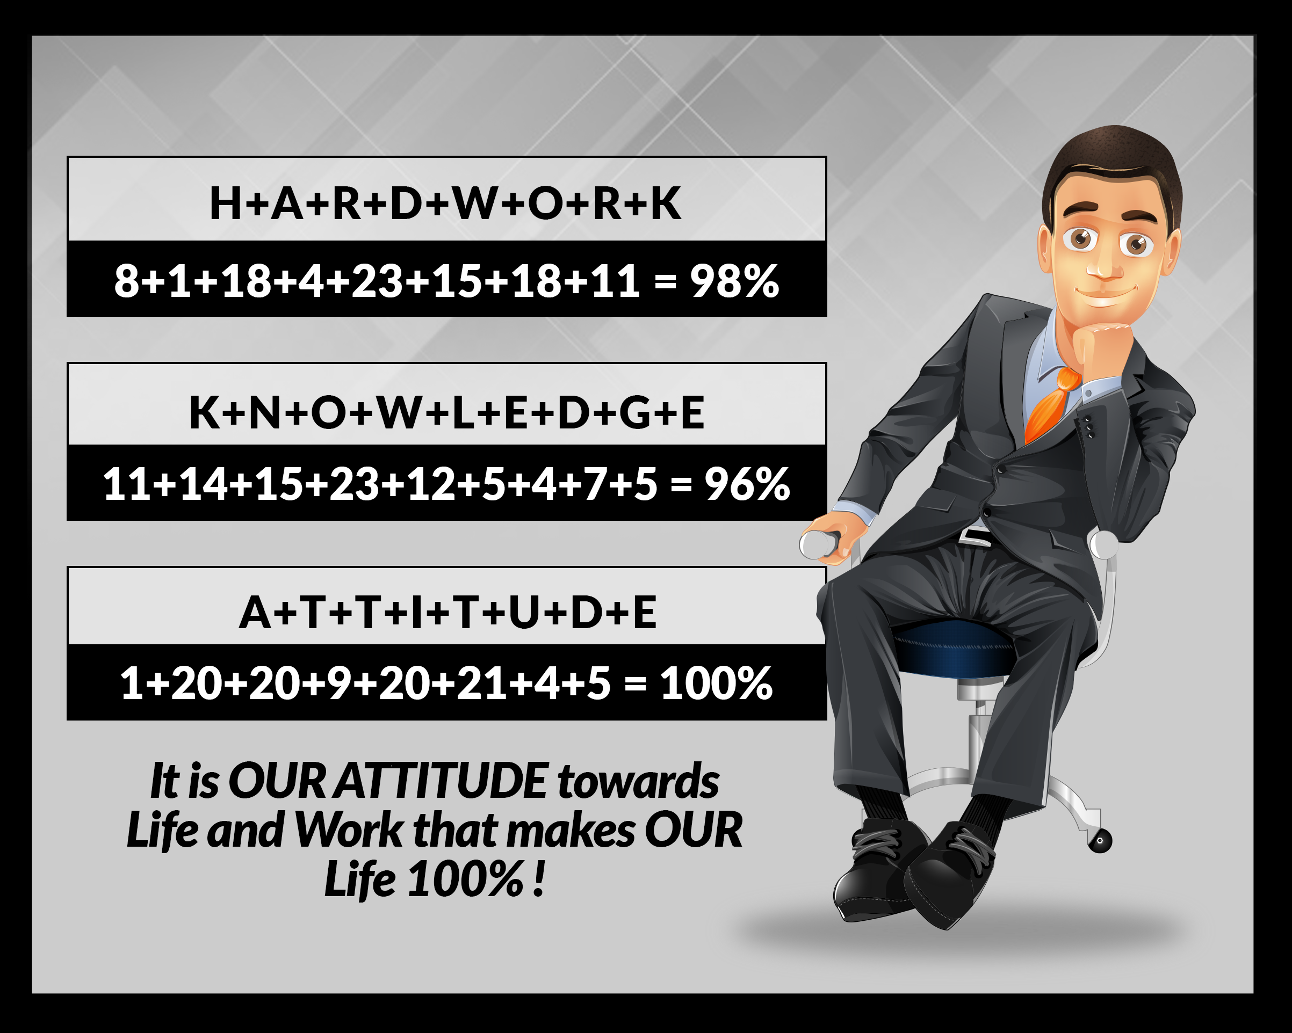

Slide 17
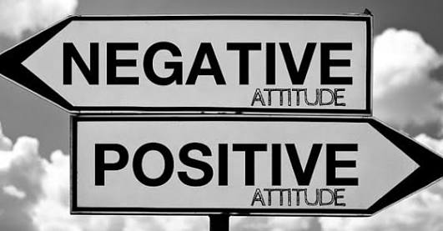


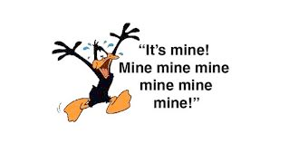
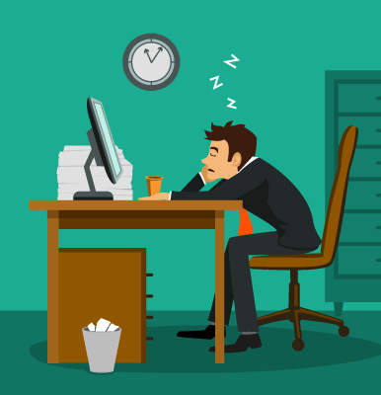
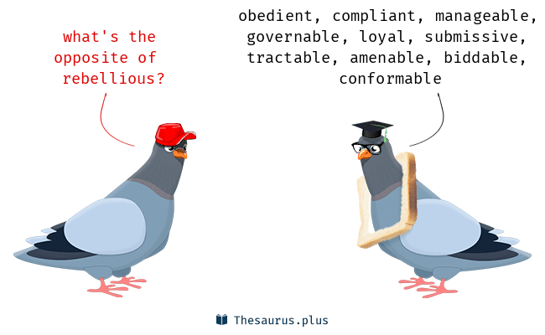
Unfriendly
Selfish
Rebellious
Angered easily
Lazy
Not accountable
Argumentative

Slide 18
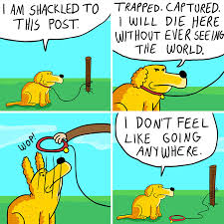
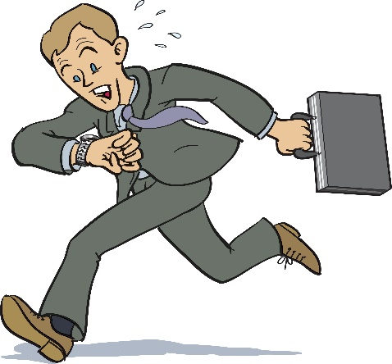
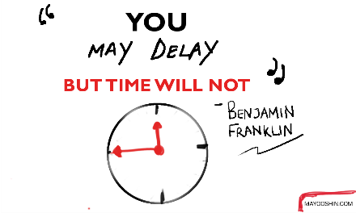

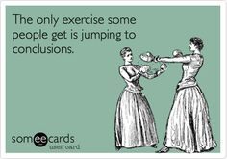

Pessimism
Procrastination
Lateness
Jumping to conclusions
Discrimination
Taking credit for others work
Disrespectful

Slide 19
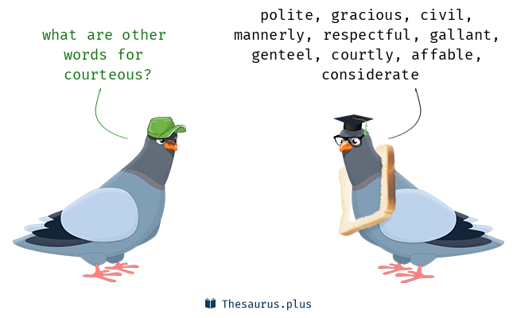

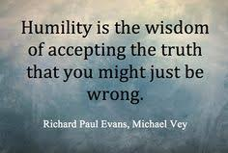
Pleasant and friendly
Courteous
Humility
Teachable
Objective
Good team player
Selfless

Slide 20
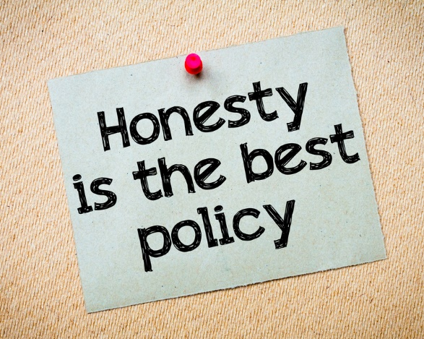
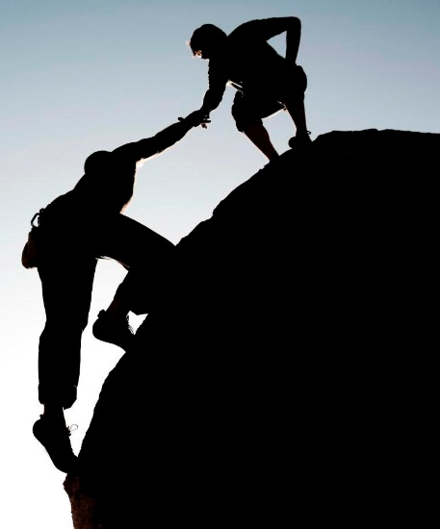



Honest
Unpretentiousness
Cooperative
Reliable
Candid
Grateful

Slide 21
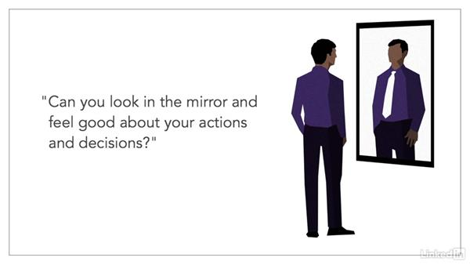

Slide 22

CAN ATTITUDE BE CHANGED?
The key to positive attitude is willingness to change
All pursuit in life is enveloped in our attitude
Great talent and skill with positive attitude will lead to success

Slide 23
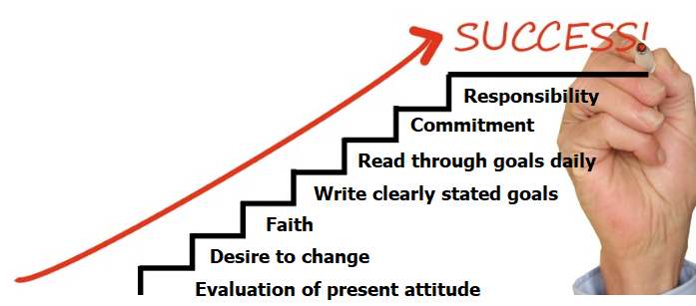
STEPS TO CHANGING ATTITUDE
Notes:
EVALUATION OF PRESENT ATTITUDE
Identify problem feeling
Identify problem behaviour
Identify problem thinking i.e. what thoughts control you

Slide 24
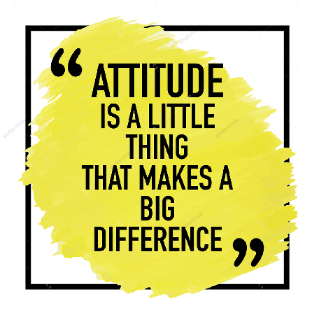
Benefits of Positive Attitude
Career success
Productivity
Notes:
Career success: Employees’ success (either through promotion or increased compensation) in the workplace is measured through their performance
Productivity: With a positive attitude, overall output and productivity are improved
https://blog.commlabindia.com/elearning-design/positive-attitude-at-workplace

Slide 25
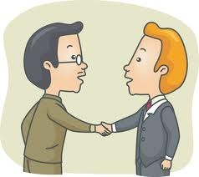
Benefits of Positive Attitude
(Cont'd)
Attitude helps with Effective communication.
Professional Tone
Body Language
Email
Notes:
Body Language:
Keep good posture and maintain eye contact
There is the tendency not to slouch
Respect personal space of others
Email:
Describe the subject of the email in the memo line
The use of titles (where appropriate)
Construct simple and understandable messages
Pay attention to punctuations

Slide 26
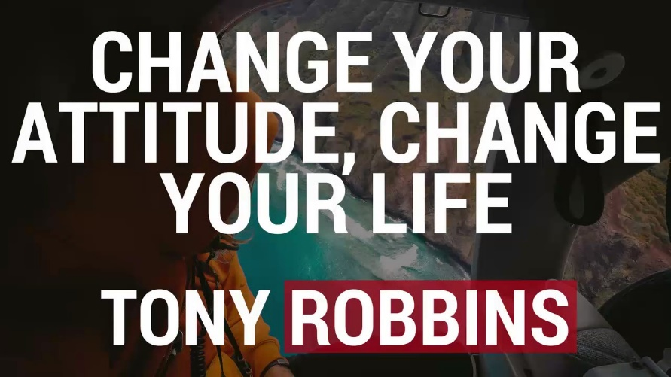
Benefits of Positive Attitude (Cont'd)
Decision making
Motivation
Interpersonal relations
Notes:
Decision making: Decisions are taken in an objective manner
Motivation: Having a positive attitude helps in motivating employees to overcome obstacles that they may face during the course of their job
Interpersonal relations: A positive attitude enables employees to share a better rapport with clients, earning valuable loyalty from clients
In conclusion, positive attitude at work is beneficial not only to the organisation, but also to the employees on an individual basis.

Slide 27

Attitude and SUCCESS
Person gets a Job 85% Times Because of Attitude and 15% for Skills
Attitude is Foundation of Success
With Right Attitude YOU can see Opportunity
Talent is not enough to create an excellent team... but having the right attitude with talent creates room for great success

Slide 28


Slide 29


Slide 30
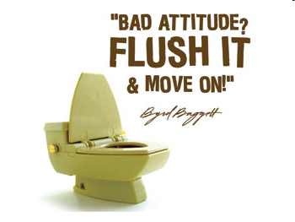

Slide 31
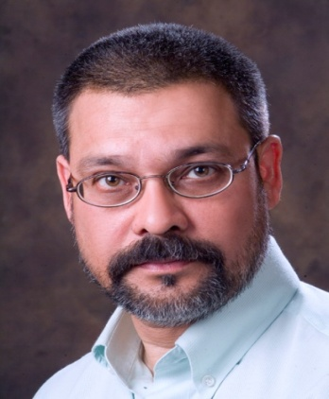
Index of Mind
Your attitude is everything
Your attitude drive behavior
Your attitude control your lives
Your attitude makes a big difference
Count your blessings not troubles
Enrich your mind with positives thoughts
Stay away from negative people
Negative thoughts is a state of depression
Attitude is the key to your success
Attitude is the index of your mind
Syed Imtiaz Hussain

Slide 32

With a Bad Attitude YOU can Never have a Positive Day and with a Positive Attitude YOU can Never have a Bad Day.
The CHOICE is YOURS!

Slide 33
QUOTES
People may hear your words, but they feel your attitude - John C. Maxwell
Adopting the right attitude can convert a negative stress into a positive one - Hans Selye
If you don't like something, change it. If you can't change it, change your attitude - Maya Angelou
It is our best friend or our worst enemy - John C. Maxwell
It is a thing which draws people to us or repels them - John C. Maxwell
It’s roots are inward but its fruit is outward - John C. Maxwell
It is more honest and more consistent than our words - John C. Maxwell

Slide 34
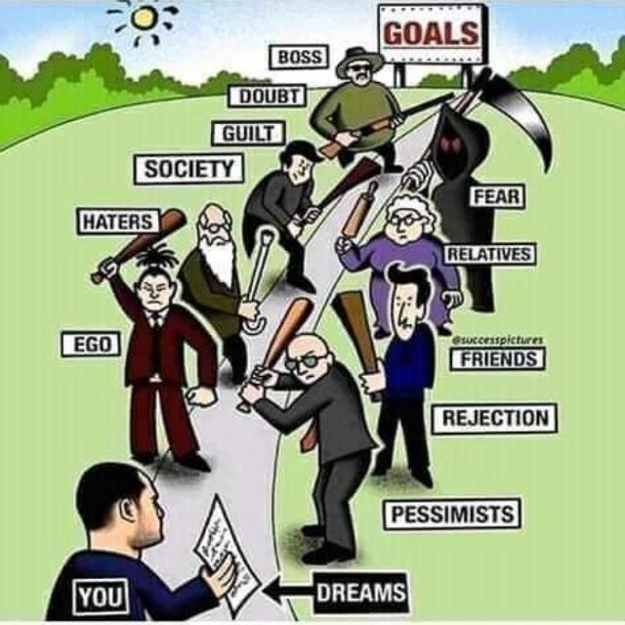

Slide 35


